Slide 1

Healthcare Analytics
(Heart Disease Prediction Using BRFSS 2015 Dataset with Python)

Slide 2
What is Healthcare Analytics?
Healthcare Analytics involves the collection, analysis and interpretation of health-related data to improve patient care, optimize hospital operations and support evidence-based decision-making. It combines data science, statistics and technology to identify trends, predict disease outbreaks and evaluate treatment effectiveness. Healthcare analytics is used to reduce costs, enhance efficiency and personalize patient experiences. It plays a vital role in preventive care by analyzing risk factors and predicting health outcomes. By leveraging electronic health records, wearable devices and demographic data, healthcare analytics empowers healthcare providers to make informed decisions, ultimately improving healthcare quality, accessibility and patient satisfaction across the system.

Slide 3
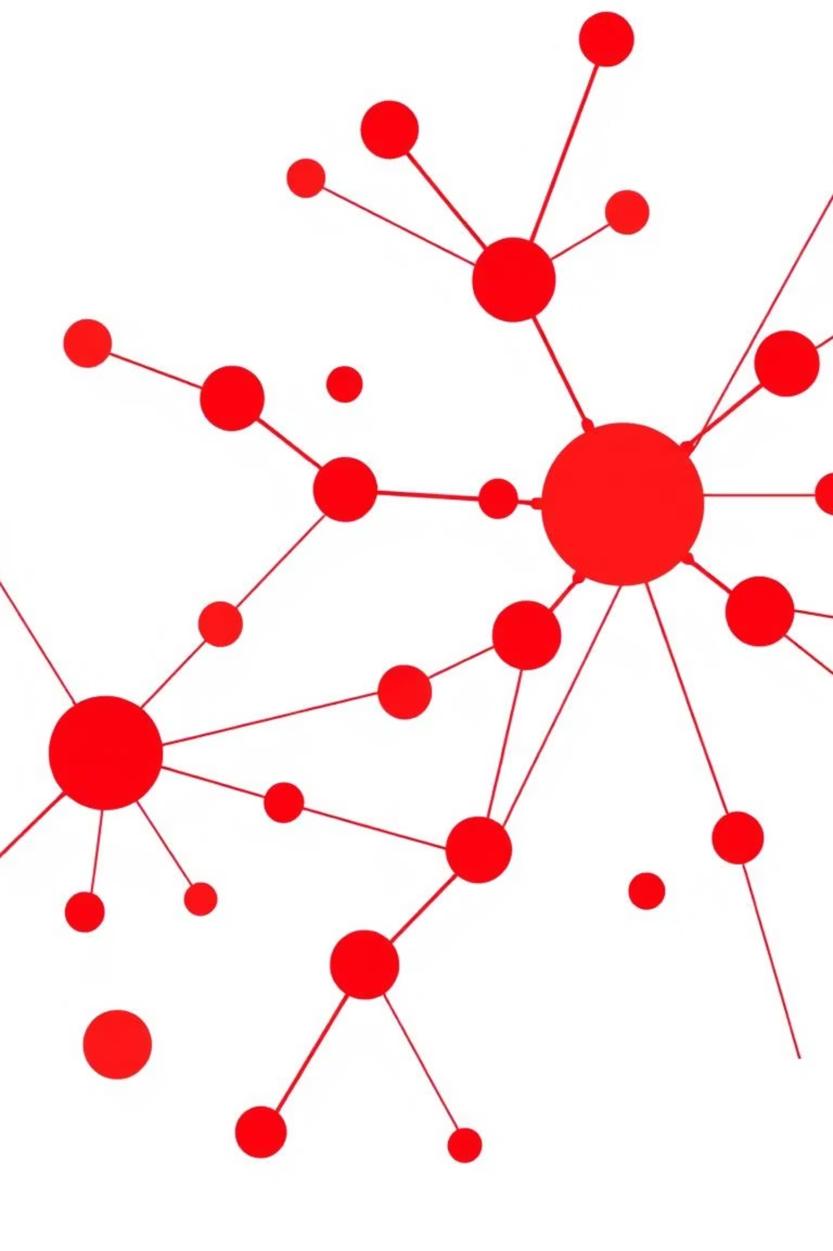
Project Overview
This project focuses on analyzing health and demographic data to predict the risk of heart disease. We utilise Python tools for comprehensive data processing, analysis, and predictive modeling.
The primary goal is to identify key risk indicators and develop robust predictive models that can contribute to early detection and prevention strategies in healthcare.

Slide 4
Dataset Information
Source
BRFSS 2015 (Behavioral Risk Factor Surveillance System)
Records
250,000+ individuals
Features
21 health and demographic indicators
Target Variable
HeartDiseaseorAttack (0 = No, 1 = Yes)
The BRFSS 2015 dataset provides a rich source of information for understanding public health behaviours and risks.

Slide 5



Tools & Technologies
Python Libraries
Techniques
Visualisation
Pandas, NumPy, Seaborn, Matplotlib, Scikit-learn for data handling and visualisation.
EDA, Feature Engineering, and Logistic Regression for model development.
Correlation Heatmaps, Countplots, and Boxplots for insightful data representation.

Slide 6
Data Preprocessing
1
2
Handle Missing Values
Normalisation
Standardised data formats and addressed missing entries.
Utilised StandardScaler for consistent data scaling.
3
4
Split Dataset
Prepare Variables
Divided data into 70% training and 30% testing sets.
Organised features (X) and target (y) for model input.

Slide 7
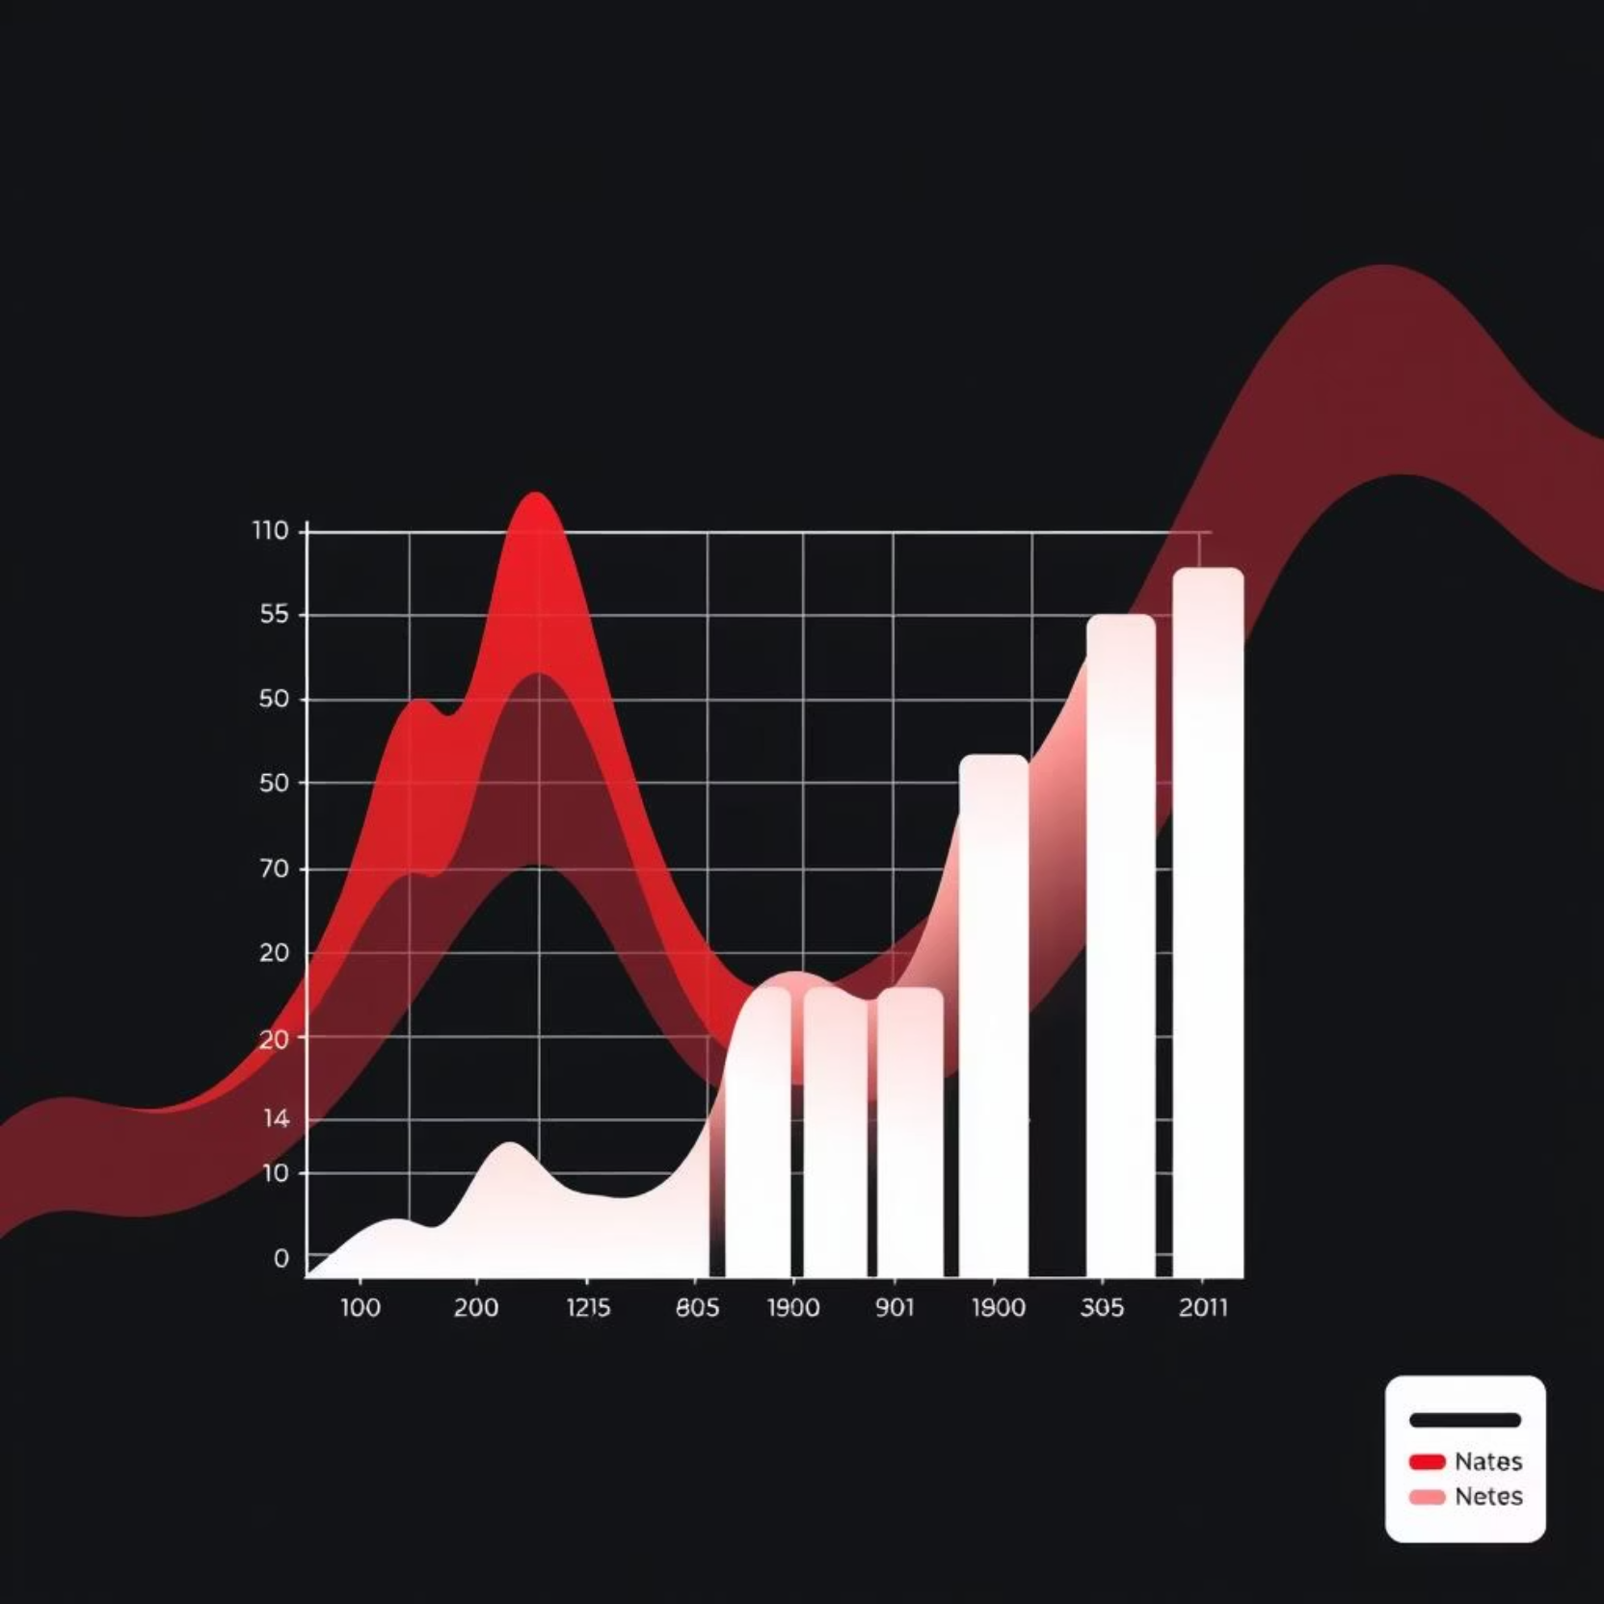
Exploratory Data Analysis (EDA)
Countplot: Revealed class imbalance with fewer heart disease cases.
Heatmap: Showed strong correlations with HighBP, Smoking, and Physical Inactivity.
Insights: Gained understanding of age group, BMI, and income category distributions.

Slide 8
Model Building
We applied Logistic Regression for binary classification to predict heart disease. The model's performance was rigorously evaluated using several key metrics.
Accuracy Score
Confusion Matrix
Classification Report
Overall correctness of the model's predictions.
Detailed breakdown of true positives, negatives, false positives, and negatives.
Provided Precision, Recall, and F1 Score for comprehensive evaluation.
Alternative models like Random Forest and SVM were also considered for potential improvements.

Slide 9
Key Insights
1
Risk Factors
2
Lifestyle Impact
3
Socioeconomic Influence
Age, BMI and smoking habits significantly increase heart disease risk.
Physical inactivity and poor mental health are contributing factors.
Income and education levels also affect heart health outcomes.

